Slide 1

Database

Slide 2
What is a database?
structured collection of data
can include text, numbers, pictures
A single-table database contains only one table.

Slide 3
Uses of Database
To store information about people, for instance:
» patients in a hospital
To store information about things, for instance:
» books in a library.
To store information about events, for instance:
» hotel bookings

Slide 4
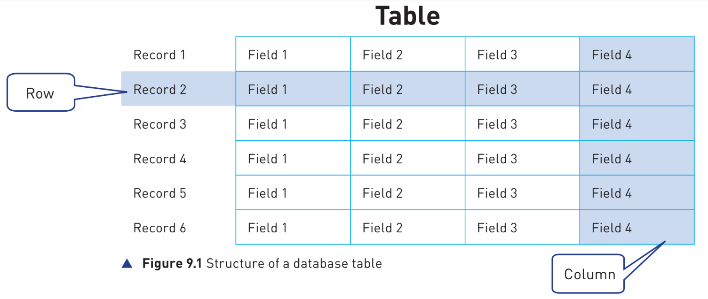
Each record is a row in the table
Each field is a column in the table.

Slide 5
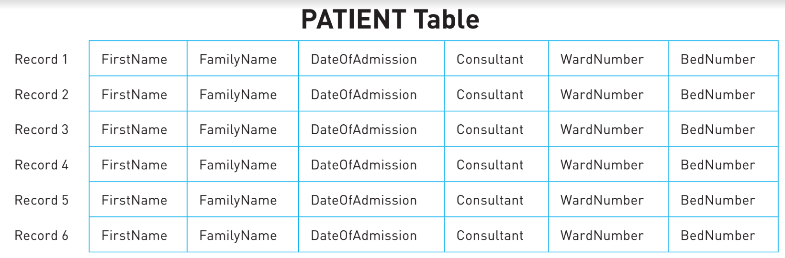
Example:
The PATIENT table structure could look like this:

Slide 6
Basic data types
There are six basic data types that you need to be able to use in a database:
» text/alphanumeric
» character
» Boolean
» integer
» real
» date/time.

Slide 7
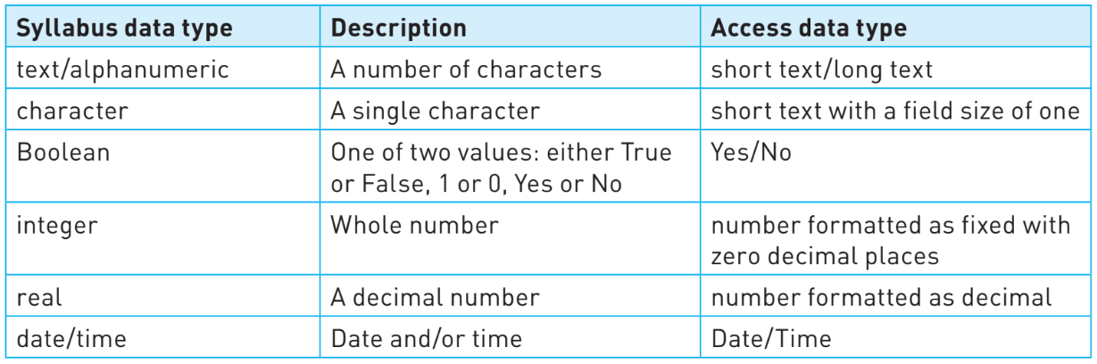
The names Access uses may be different from the terms in the syllabus.

Slide 8
Primary keys
In order to reliably identify an item from the data stored about it in a record there needs to be a field that uniquely identifies the item. This field is called the primary key.
A field that is a primary key must contain data values that are never repeated in the table.
The PATIENT table would need an extra field for each record as all of the existing fields could contain repeated data.
To create a primary key, we could add a new field to each record, for example a unique number could be added to each patient’s record.
The extra field is:
» Primary key field called HospitalNumber

Slide 9
Structured Query Language
(SQL)

Slide 10
SQL
standard query language.
to obtain useful information from a database.
SQL scripts
list of SQL commands
Used to perform a given task
often stored in a file so the script can be reused
You can write scripts using SQL commands in Access.

Slide 11
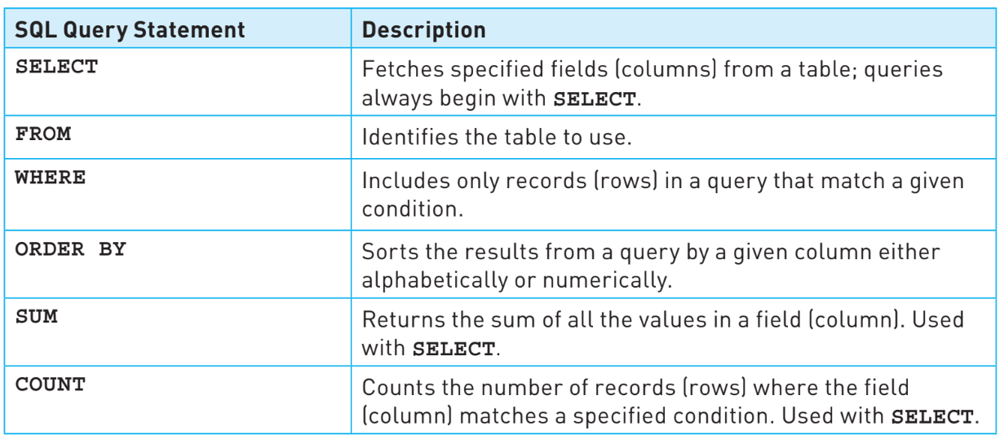

Slide 12
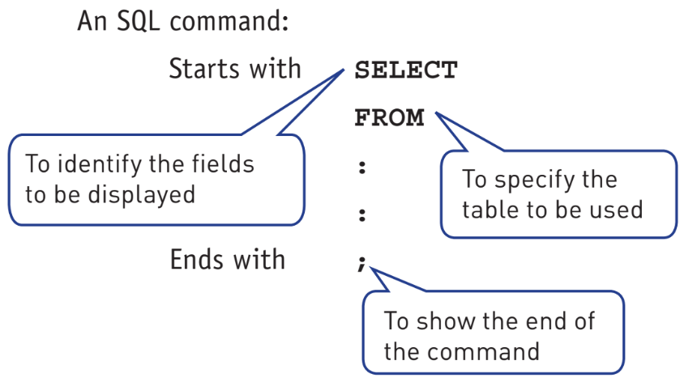
Only the SELECT and FROM commands are mandatory in an SQL script. All other commands are optional.

Slide 13
A SELECT statement takes the form:
SELECT Field1, Field2, Field3, etc. – this specifies the individual fields (columns) to be shown.
SELECT * – this specifies that all fields (columns) are to be shown.
A FROM statement takes the form:
FROM TableName – this specifies the table to use.
A WHERE statement takes the form:
WHERE Condition – this specifies the condition to apply.
An ORDER BY statement takes the form:
ORDER BY Field1, Field2, etc. – this specifies a sort in ascending or alphabetical order
ORDER BY Field1, Field2 DESC – this specifies a sort in descending or reverse alphabetical order
A SUM statement takes the form:
SELECT SUM (Field) – this specifies the field (column) for the calculation.
A COUNT statement takes the form:
SELECT COUNT (Field) – this specifies the field (column) to count if the given criteria is met.

Slide 14
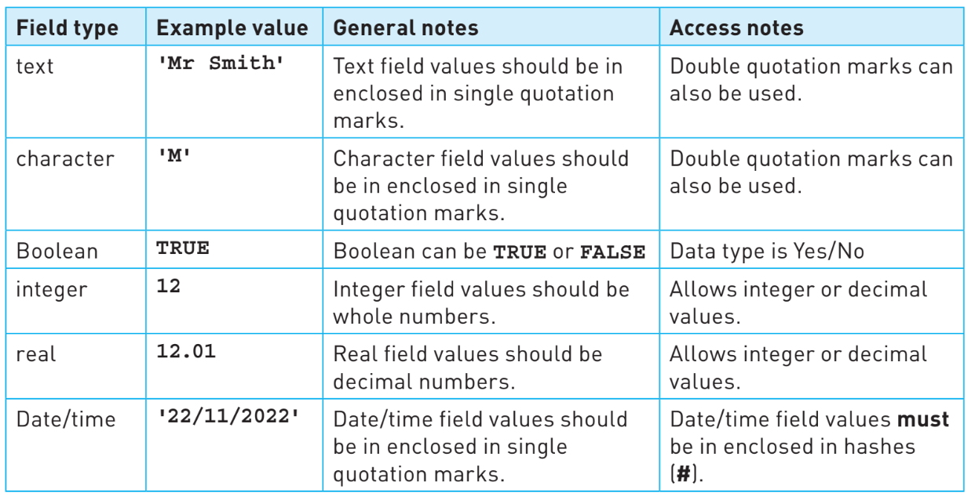
Conditions often include values from fields, these values need to be stated in a form that matches the data type for the field.

Slide 15
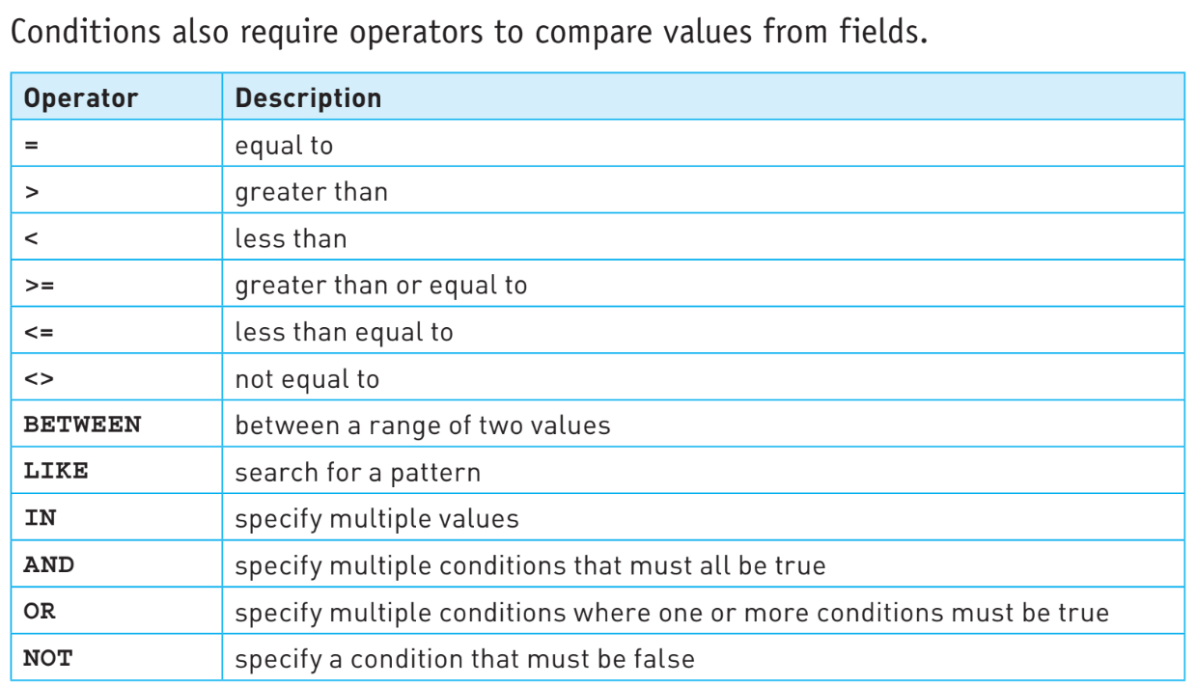

Slide 16
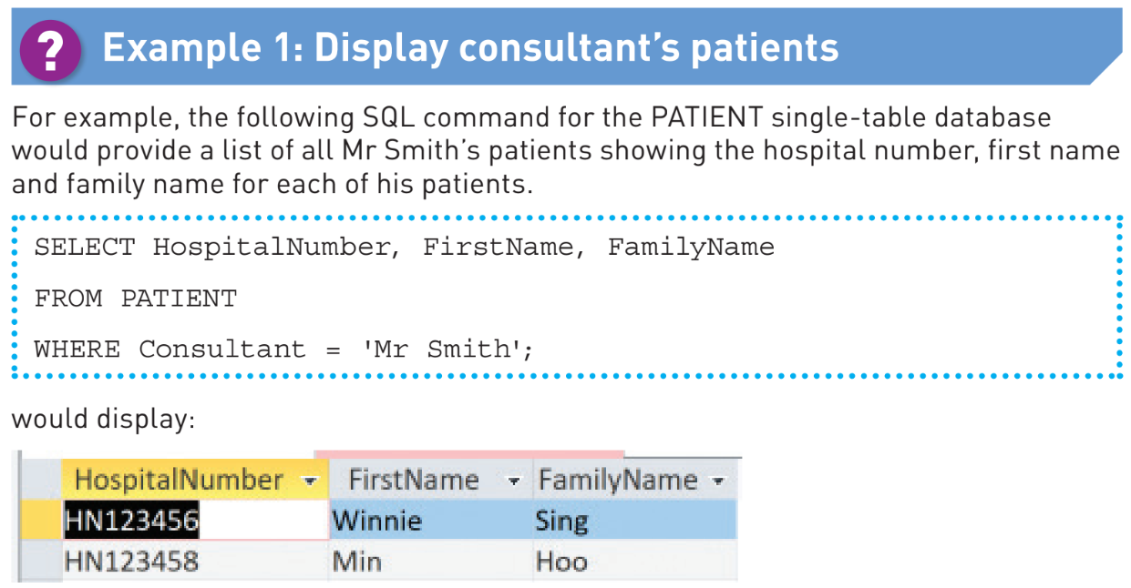

Slide 17
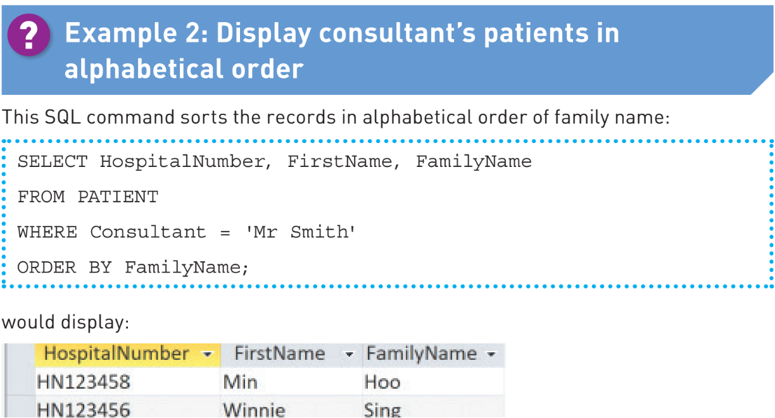

Slide 18
Quiz -
https://forms.gle/RJ5mMhDFgAQVzrWh6

